Slide 1

307304 Data Mining
Association Rules Mining & Apriori Algorithm
2024-2

Slide 2
Learning Objectives
By the end of this lecture, you will:
Understand association rules and their real-world applications
Master key metrics: support, confidence, and lift
See how each metric helps filter and rank rules
Explain the Apriori algorithm step-by-step
Apply the algorithm to find actionable business insights

Slide 3
What Are We Actually Associating?
Real-World Association Examples
Retail/E-commerce:
Items ↔ Items: "Customers who buy diapers also buy beer"
Used for: Product placement, cross-selling, bundle offers
Healthcare:
Symptoms ↔ Diseases: "Patients with fever and headache often have flu"
Drugs ↔ Side Effects: "Patients taking Drug A often experience nausea"
Used for: Diagnosis support, drug safety monitoring
Web Analytics:
Pages ↔ Pages: "Users who visit Product Page A also visit Product Page B"
Actions ↔ Actions: "Users who click 'Add to Cart' also click 'View Reviews'"
Used for: Website optimization, content recommendations
The Key Question: "When X happens, what else is likely to happen?"

Slide 4
Why Association Rules Matter
Business Impact Examples
Supermarket Chain Discovery:
Rule: {Diapers} → {Beer} (confidence: 65%, lift: 1.8)
Action: Place beer near baby products
Result: 25% increase in beer sales on weekends
E-commerce Recommendation:
Rule: {iPhone} → {Phone Case} (confidence: 78%, lift: 2.1)
Action: Auto-suggest phone cases during iPhone checkout
Result: 40% of iPhone buyers also purchase cases
Website Navigation:
Rule: {View Pricing} → {Contact Sales} (confidence: 45%, lift: 3.2)
Action: Add prominent "Contact Sales" button on pricing page
Result: 60% increase in sales inquiries

Slide 5
Basic Terminology
Our Grocery Store Dataset
Transaction ID | Items Purchased
T1 | {Bread, Milk, Eggs}
T2 | {Bread, Butter, Cheese}
T3 | {Milk, Butter, Cheese, Yogurt}
T4 | {Bread, Milk, Butter}
T5 | {Bread, Milk, Eggs, Cheese}
T6 | {Butter, Cheese, Yogurt}
T7 | {Bread, Butter, Eggs}
T8 | {Milk, Cheese, Yogurt}
T9 | {Bread, Milk, Butter, Cheese}
T10 | {Eggs, Cheese, Yogurt}
Key Terms
Transaction: One customer's shopping trip
Itemset: Group of items, e.g., {Bread, Milk}
Association Rule: X → Y, e.g., {Bread} → {Milk}

Slide 6
Support - "How Popular Is This Pattern?"
Definition
Percentage of transactions containing the itemset
Formula
Support(X) = Count(transactions with X) / Total transactions
Calculations from Our Data
Support({Bread}) = 6/10 = 60%
Support({Milk}) = 5/10 = 50%
Support({Butter}) = 5/10 = 50%
Support({Cheese}) = 6/10 = 60%
Support({Bread, Milk}) = 3/10 = 30%
Support({Butter, Cheese}) = 4/10 = 40%
Why Support Matters
High support: Common, reliable patterns
Low support: Rare, potentially spurious patterns
Threshold: Typically 5-20% depending on business context

Slide 7
Confidence - "How Reliable Is This Rule?"
Definition
When X is bought, what's the probability Y is also bought?
Formula
Confidence(X → Y) = Support(X ∪ Y) / Support(X)
Key Comparison - Direction Matters!
{Bread} → {Milk}: Confidence = Support({Bread, Milk}) / Support({Bread}) = 30% / 60% = 50%
{Milk} → {Bread}: Confidence = Support({Bread, Milk}) / Support({Milk}) = 30% / 50% = 60%
Business Insight
Milk buyers are MORE likely to buy bread (60%) than bread buyers are to buy milk (50%)
Action: Target bread promotions to milk buyers, not vice versa

Slide 8
Confidence Reveals Asymmetric Relationships
More Examples from Our Data
{Butter} → {Cheese}: Confidence = Support({Butter, Cheese}) / Support({Butter}) = 40% / 50% = 80%
{Cheese} → {Butter}: Confidence = Support({Butter, Cheese}) / Support({Cheese}) = 40% / 60% = 67%
Business Decision
Higher confidence: {Butter} → {Cheese} (80%)
Strategy: When customers buy butter, strongly recommend cheese
Expected success rate: 8 out of 10 butter buyers will accept cheese recommendation
Why This Matters
Confidence helps us choose the RIGHT DIRECTION for recommendations

Slide 9
The Problem with Confidence Alone
Misleading High Confidence Example
{Eggs} → {Cheese}: Support({Eggs, Cheese}) = 2/10 = 20% Support({Eggs}) = 4/10 = 40% Confidence = 20% / 40% = 50%
Seems reasonable, but...
Overall popularity of Cheese = Support({Cheese}) = 60%
The Problem
Confidence: 50% of eggs buyers buy cheese
Reality: 60% of ALL customers buy cheese
Truth: Buying eggs actually DECREASES cheese probability!
This is where LIFT comes to the rescue!

Slide 10
Lift - "Is This Really Meaningful?"
Definition
How much more likely is Y when X is present vs. Y's general popularity?
Formula
Lift(X → Y) = Confidence(X → Y) / Support(Y)
The Eggs → Cheese Example Revisited
Lift({Eggs} → {Cheese}) = 50% / 60% = 0.83
Interpretation
Lift < 1: Negative correlation (buying eggs REDUCES cheese likelihood)
Lift = 1: Independence (no relationship)
Lift > 1: Positive correlation (buying X INCREASES Y likelihood)
Business Insight
Don't recommend cheese to eggs buyers - they're LESS likely to buy it!

Slide 11
Lift Reveals True Relationships
Positive Correlation Example
{Butter} → {Cheese}: Confidence = 80% Lift = 80% / 60% = 1.33
Interpretation: Butter buyers are 33% MORE likely to buy cheese than average
Independence Example
{Bread} → {Milk}: Confidence = 50% Lift = 50% / 50% = 1.00
Interpretation: Bread purchase doesn't affect milk purchase probability
Negative Correlation Example
{Yogurt} → {Bread}:
Support({Yogurt, Bread}) = 0/10 = 0%
Support({Yogurt}) = 3/10 = 30%
Confidence = 0% / 30% = 0%
Lift = 0% / 60% = 0.00
Interpretation: Yogurt buyers NEVER buy bread - strong negative correlation

Slide 12
Why We Need All Three Metrics
Complete Rule Evaluation
Rule | Support | Confidence | Lift | Business Value
{Butter} → {Cheese} | 40% | 80% | 1.33 | HIGH ✓
{Milk} → {Bread} | 30% | 60% | 1.00 | NONE ✗
{Eggs} → {Cheese} | 20% | 50% | 0.83 | NEGATIVE ✗
{Cheese} → {Yogurt} | 15% | 25% | 0.83 | WEAK ✗
Each Metric's Role
Support: Filters out rare patterns (need enough data)
Confidence: Ensures rule reliability (high success rate)
Lift: Confirms true correlation (not just coincidence)
Best Rule: {Butter} → {Cheese}
40% support: Frequent enough to be reliable
80% confidence: 4 out of 5 butter buyers will buy cheese
1.33 lift: 33% more likely than random chance

Slide 13
Apriori Algorithm Overview
Core Principle: Apriori Property
"All subsets of a frequent itemset must be frequent"
Example
If {Bread, Milk, Butter} is frequent, then:
{Bread, Milk} must be frequent
{Bread, Butter} must be frequent
{Milk, Butter} must be frequent
{Bread}, {Milk}, {Butter} must be frequent
Pruning Power
If {Bread, Milk} is NOT frequent, then:
{Bread, Milk, Butter} cannot be frequent
{Bread, Milk, Cheese} cannot be frequent
Any superset containing {Bread, Milk} can be eliminated

Slide 14
Apriori Algorithm Steps
Algorithm Workflow
Find L₁: Count all items, keep frequent ones
Generate candidates: Combine frequent (k-1)-itemsets
Prune candidates: Remove those with infrequent subsets
Count support: Scan database for remaining candidates
Filter: Keep only frequent k-itemsets
Repeat: Until no new frequent itemsets found
Generate rules: From all frequent itemsets
Parameters for Our Example
Minimum Support: 30% (3 out of 10 transactions)
Minimum Confidence: 60%
Minimum Lift: 1.2

Slide 15
Iteration 1 - Find Frequent Items
Count Individual Items
Item | Count | Support | Status
Bread | 6 | 60% | ✓
Milk | 5 | 50% | ✓
Butter | 5 | 50% | ✓
Cheese | 6 | 60% | ✓
Eggs | 4 | 40% | ✓
Yogurt | 3 | 30% | ✓
Result: L₁ (Frequent 1-itemsets)
All items meet 30% minimum support threshold
L₁ = {{Bread}, {Milk}, {Butter}, {Cheese}, {Eggs}, {Yogurt}}

Slide 16
Iteration 2 - Find Frequent Pairs
Generate All Possible Pairs
6 items → 15 possible pairs
Count Support for Each Pair
Itemset | Transactions | Count | Support | Status
{Bread, Milk} | T1,T4,T5,T9 | 4 | 40% | ✓
{Bread, Butter} | T2,T4,T7,T9 | 4 | 40% | ✓
{Bread, Cheese} | T2,T5,T9 | 3 | 30% | ✓
{Bread, Eggs} | T1,T5,T7 | 3 | 30% | ✓
{Bread, Yogurt} | None | 0 | 0% | ✗
{Milk, Butter} | T3,T4,T9 | 3 | 30% | ✓
{Milk, Cheese} | T3,T5,T8,T9 | 4 | 40% | ✓
{Milk, Eggs} | T1,T5 | 2 | 20% | ✗
{Milk, Yogurt} | T3,T8 | 2 | 20% | ✗
{Butter, Cheese} | T2,T3,T6,T9 | 4 | 40% | ✓
{Butter, Eggs} | T7 | 1 | 10% | ✗
{Butter, Yogurt} | T3,T6 | 2 | 20% | ✗
{Cheese, Eggs} | T5,T10 | 2 | 20% | ✗
{Cheese, Yogurt} | T3,T6,T8,T10 | 4 | 40% | ✓
{Eggs, Yogurt} | T10 | 1 | 10% | ✗

Slide 17
Iteration 2 Results
L₂ (Frequent 2-itemsets)
{Bread, Milk} - 40% support {Bread, Butter} - 40% support {Bread, Cheese} - 30% support {Bread, Eggs} - 30% support {Milk, Butter} - 30% support {Milk, Cheese} - 40% support {Butter, Cheese} - 40% support {Cheese, Yogurt} - 40% support
Key Observations
8 frequent pairs out of 15 possible
{Bread, Yogurt} has 0% support - strong negative correlation
{Butter, Cheese} has highest support (40%) - good combination

Slide 18
Iteration 3 - Generate 3-itemset Candidates
Step 1: Candidate Generation (Join Step)
Combine frequent 2-itemsets that share exactly one item:
{Bread, Milk} + {Bread, Butter} → candidate {Bread, Milk, Butter}
{Bread, Milk} + {Bread, Cheese} → candidate {Bread, Milk, Cheese}
{Bread, Butter} + {Bread, Cheese} → candidate {Bread, Butter, Cheese}
{Milk, Butter} + {Milk, Cheese} → candidate {Milk, Butter, Cheese}
Step 2: Prune Candidates (Based on Apriori Property)
For each candidate, check if ALL its 2-subsets are frequent:
{Bread, Milk, Butter}:
{Bread, Milk} ✓ (in L₂), {Bread, Butter} ✓ (in L₂), {Milk, Butter} ✓ (in L₂)
Keep candidate
{Bread, Milk, Cheese}:
{Bread, Milk} ✓ (in L₂), {Bread, Cheese} ✓ (in L₂), {Milk, Cheese} ✓ (in L₂)
Keep candidate
Step 3: Ready for Database Scan
4 candidates survive pruning - now we check which ones actually exist in transactions!

Slide 19
Iteration 3 - Count Actual Support in Database
Step 4: Database Scan (The Crucial Step!)
Now we check: Do these 3 items actually appear together in real transactions?
Candidate | Which Transactions? | Count | Support | Status
{Bread, Milk, Butter} | T4, T9 | 2 | 20% | ✗
{Bread, Milk, Cheese} | T5, T9 | 2 | 20% | ✗
{Bread, Butter, Cheese} | T2, T9 | 2 | 20% | ✗
{Milk, Butter, Cheese} | T3, T9 | 2 | 20% | ✗
Let's Verify One Example:
{Bread, Milk, Butter} appears in:
T4: {Bread, Milk, Butter} ✓
T9: {Bread, Milk, Butter, Cheese} ✓
Count: 2 transactions out of 10 = 20% support
Result: L₃ = {} (Empty Set)
No 3-itemsets meet our 30% minimum support threshold
Algorithm Terminates
Cannot generate any 4-itemsets since L₃ is empty

Slide 20
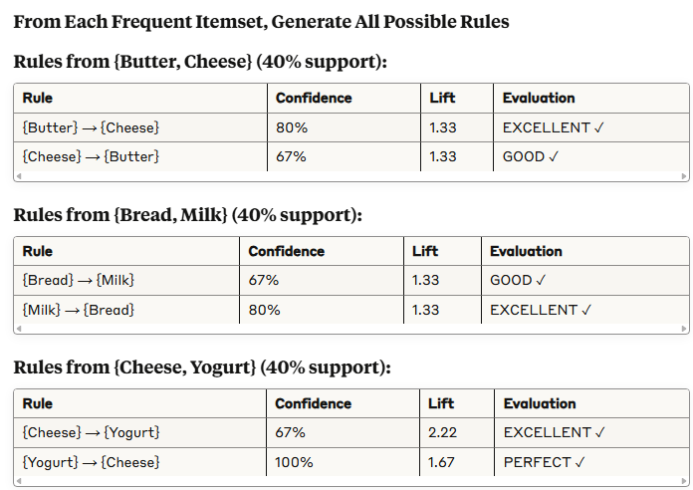
Generate Association Rules

Slide 21
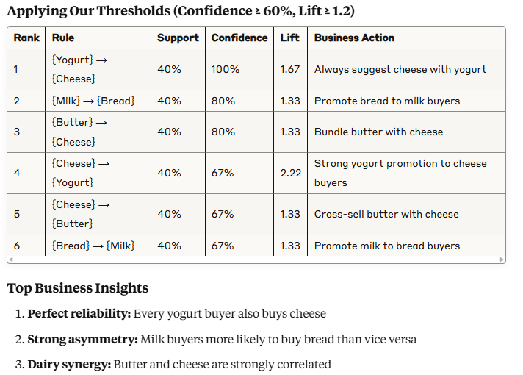
Final Rule Ranking

Slide 22
Why Each Metric Was Essential
Support Eliminated Rare Patterns
{Eggs, Yogurt}: Only 10% support → Too rare to be reliable
{Bread, Yogurt}: 0% support → Strong negative correlation discovered
Confidence Revealed Direction
{Butter} → {Cheese}: 80% confidence
{Cheese} → {Butter}: 67% confidence
Action: Prioritize cheese recommendations to butter buyers
Lift Identified True Correlations
{Cheese} → {Yogurt}: 67% confidence seems modest
But lift = 2.22: Cheese buyers are 122% more likely to buy yogurt!
Insight: This is actually a very strong relationship
Combined Power
Without all three metrics, we would miss the strongest business opportunities and waste resources on weak relationships

Slide 23
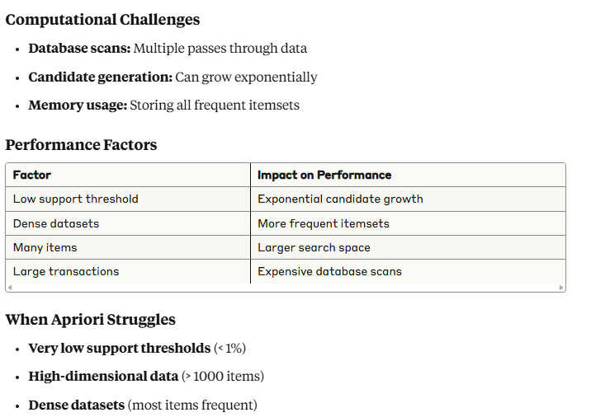
Computational Complexity and Limitations

Slide 24
Alternative Algorithms
FP-Growth
Advantage: Only 2 database scans
Method: Compact FP-tree data structure
Best for: Dense datasets, low support thresholds
ECLAT
Advantage: Vertical data representation
Method: Set intersection operations
Best for: Sparse datasets, many unique items
Modern Approaches
Parallel processing: Distributed Apriori implementations
Approximate algorithms: Trade accuracy for speed
Streaming algorithms: Handle continuous data flows

Slide 25
Practical Business Applications
Supermarket Chain Strategy
Discovered Rules:
{Yogurt} → {Cheese} (100% confidence, 1.67 lift)
{Butter} → {Cheese} (80% confidence, 1.33 lift)
Business Actions:
Place cheese display near yogurt section
Create butter-cheese bundle promotions
Stock cheese heavily when yogurt sales increase
E-commerce Recommendations
Discovered Rules:
{Milk} → {Bread} (80% confidence, 1.33 lift)
Implementation:
"Customers who bought milk also bought bread"
Automatic cross-sell suggestions
Email marketing campaigns
Inventory Management
Negative Correlations:
{Bread, Yogurt} (0% support)
Insight: Customers segment into different dietary preferences Action: Separate promotional campaigns for different customer segments

Slide 26
Summary & Key Takeaways
What We Learned
Support filters rare, unreliable patterns
Confidence reveals directional strength and asymmetry
Lift distinguishes real correlation from coincidence
All three metrics together prevent false insights
Algorithm Insights
Apriori property enables efficient search space pruning
Multiple database scans are the main performance bottleneck
Parameter tuning dramatically affects both performance and results
Business Value
Actionable insights for cross-selling and recommendations
Customer behavior understanding beyond simple popularity
Data-driven decisions for product placement and marketing
Critical Success Factors
Domain expertise to interpret and validate rules
Proper preprocessing to clean and prepare data
Continuous monitoring to ensure rules remain relevant

Slide 27
Next Steps & Advanced Topics
Immediate Applications
Implement basic Apriori on your own datasets
Experiment with thresholds to understand trade-offs
Validate discovered rules with domain experts
Advanced Techniques
Sequential pattern mining: Time-ordered associations
Multi-level associations: Category hierarchies
Constraint-based mining: User-specified business rules
Modern Developments
Real-time association mining for streaming data
Privacy-preserving techniques for sensitive data
Deep learning approaches for complex pattern discovery
Tools to Explore
Python: mlxtend, apyori libraries
R: arules, arulesViz packages
Spark: MLlib for large-scale mining

